Slide 1



NCAAFootballAnalysis
View in Power BI
Last data refresh:
12/2/2022 7:12:42 AM UTC
Downloaded at:
12/2/2022 7:15:02 AM UTC

Slide 2
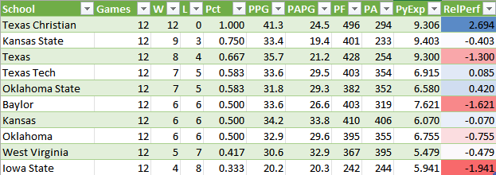
Sample Excel Spreadsheet Created from .csv File

Slide 3
Pythagorean Expectation (or Pythagorean Wins; ‘PyExp’) is a calculation of the number of wins expected based on the points a team scored vs how many points they allowed. PyExp is determined by the following formula:
PyExp = ((Total Points For)^2.37)/(((Total Points For)^2.37)+(Total Points Against)^2.37)*Games Played)
I created an additional column ‘RelPerf’ for the Relative Performance of the given team, comparing their actual wins to the number of wins expected.
This is calculated as follows:
RelPerf = Wins - PyExp

Slide 4
This is the formula I used in Power Query in order to calculate PyExp (rounded to 3 decimal places):
= Number.Round (Value.Multiply (Value.Divide ((Number.Power ([PF], 2.37)), (Value.Add ((Number.Power([PA],2.37)), (Number.Power ([PF], 2.37))))),12), 3)
And this was used to calculate RePerf:
= Value.Subtract([W],[PyExp])

Slide 5
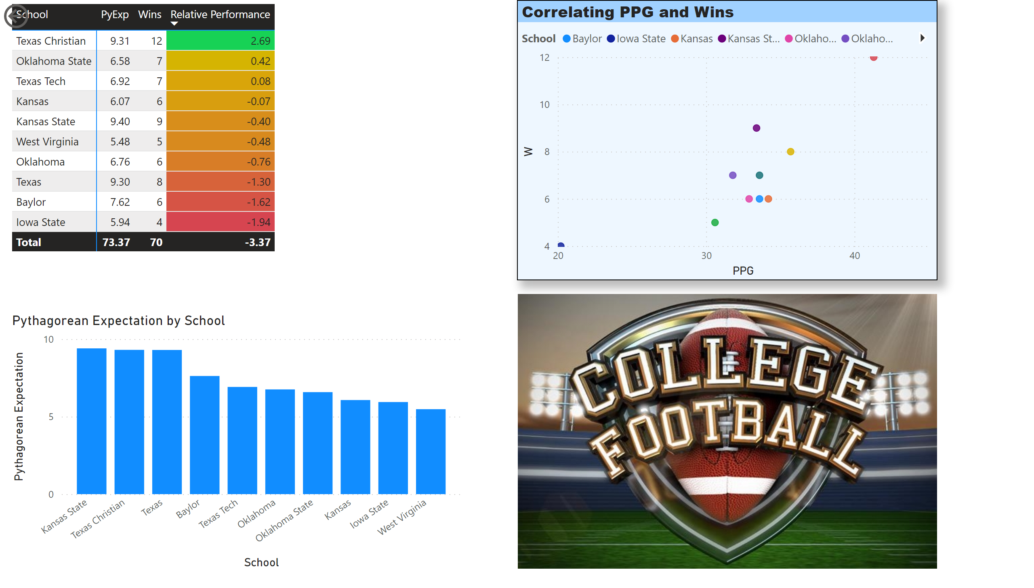
Page 1
Notes:
pivotTable
No alt text provided
actionButton
No alt text provided
Correlating PPG and Wins
No alt text provided
columnChart
No alt text provided
image
No alt text provided

Slide 6
All statistical data acquired from:
https://www.sports-reference.com/cfb/
Date retrieved: 12/1/2022

